Slide 1

Movie Rating Projece

Slide 2
Problem tatement

Slide 3
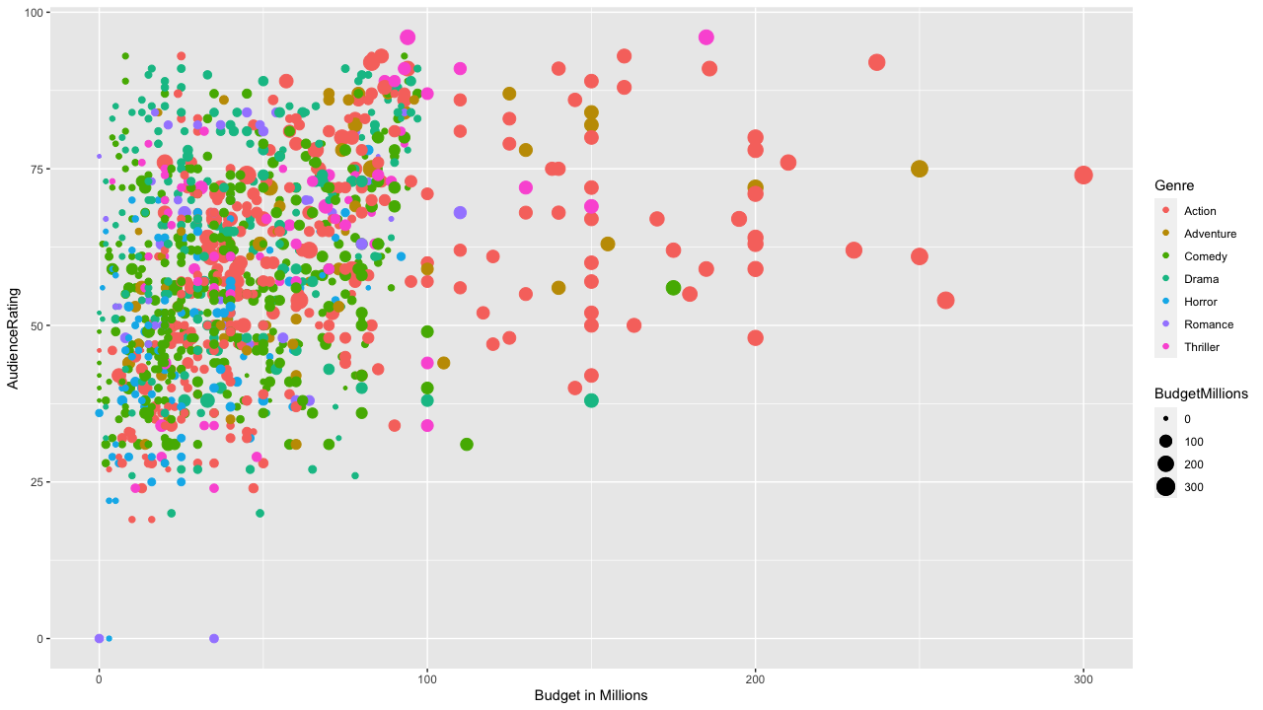
Audience Rating Vs Budget in Millions

Slide 4
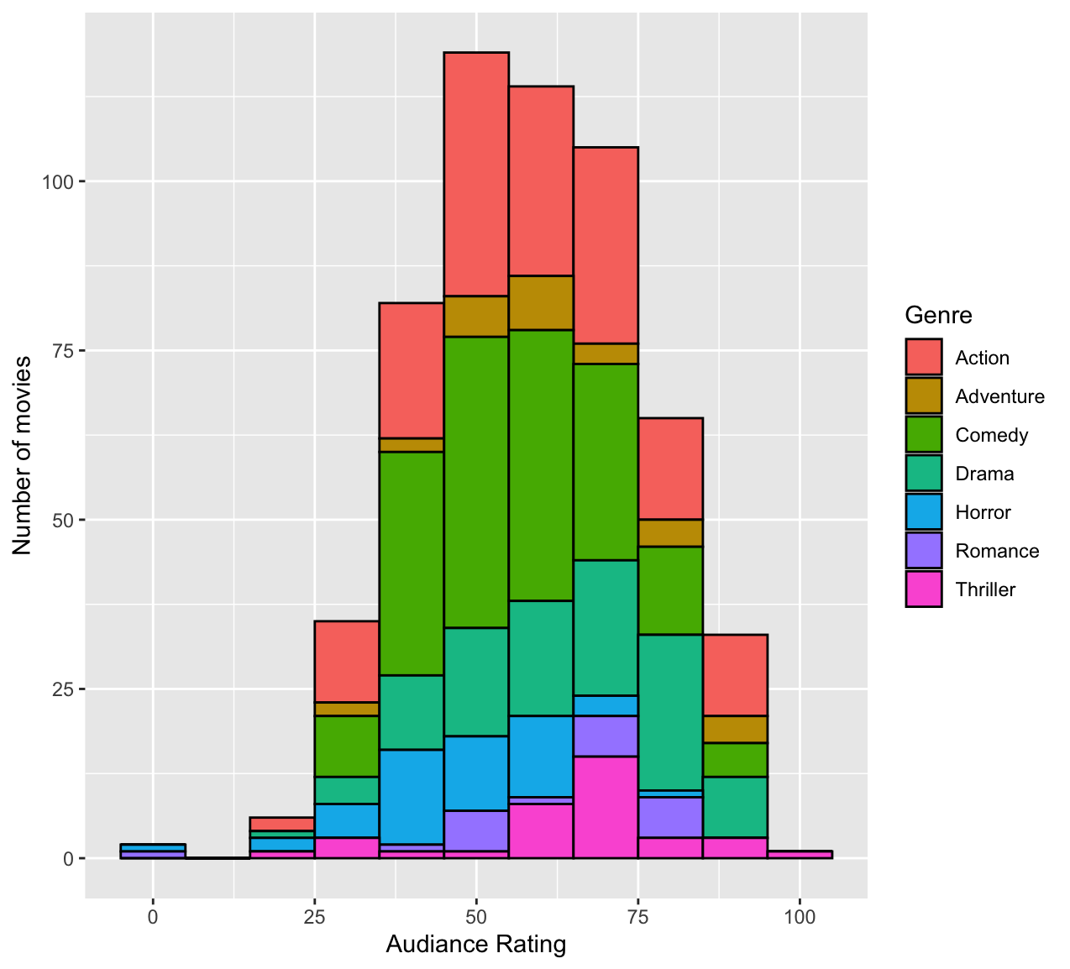
Audience Rating

Slide 5
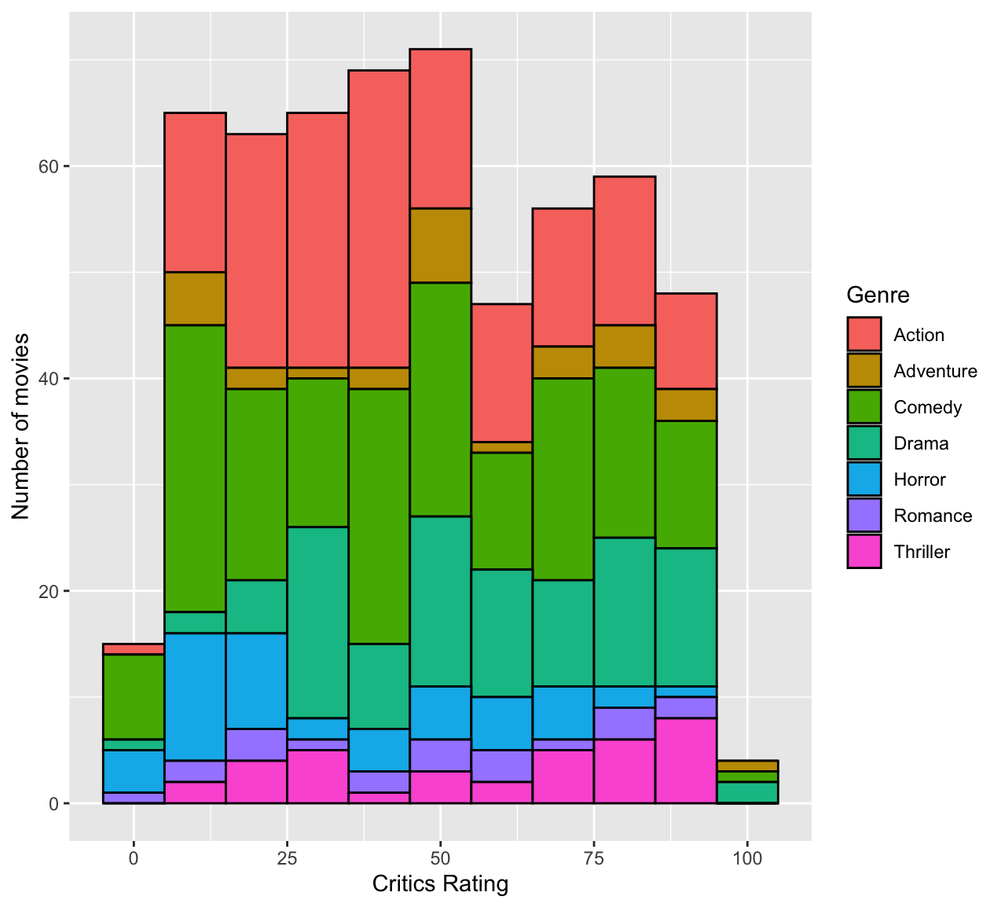
Critics Rating

Slide 6
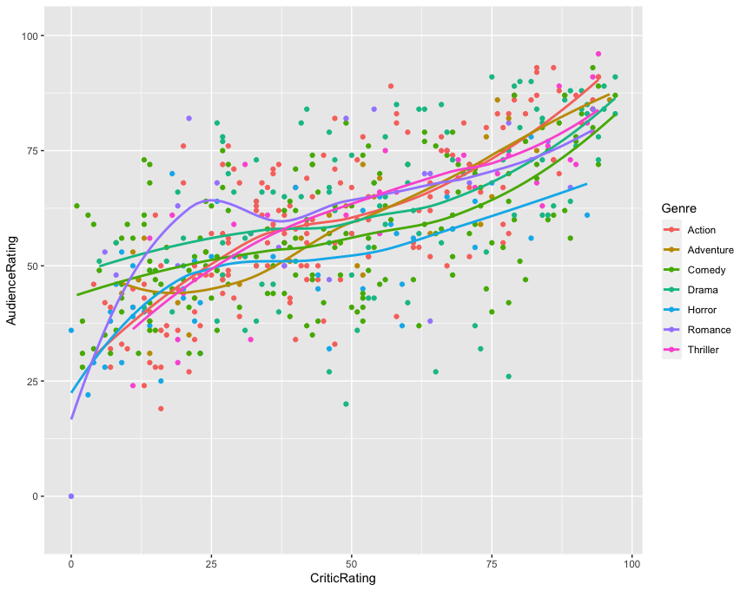
Statistical Trend between Audience Rating and Critics Rating

Slide 7
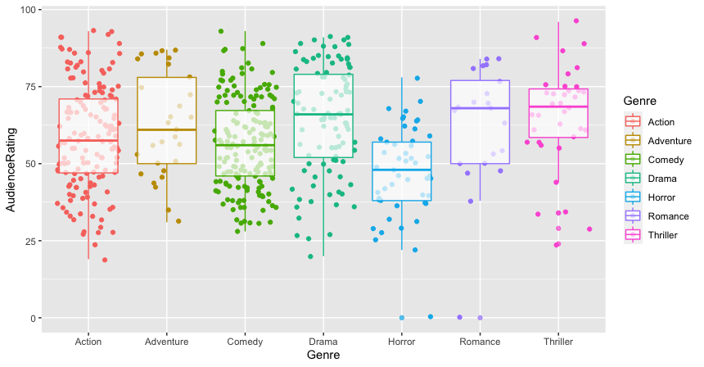
Audience Rating Compared to Genre

Slide 8
